Slide 1
Pacific Northwest National Lab (PNNL) and Marine Autonomy
Theodore (Ted) Nowak
Data Scientist

Slide 2
About me
Overview of Pacific Northwest National Lab (PNNL) and the Marine and Coastal Research Lab (MCRL) in Sequim
Introduction to Artificial Intelligence (AI)
Marine AI at MCRL

Slide 3
Interrupt me at any time and ask me anything!

Slide 4
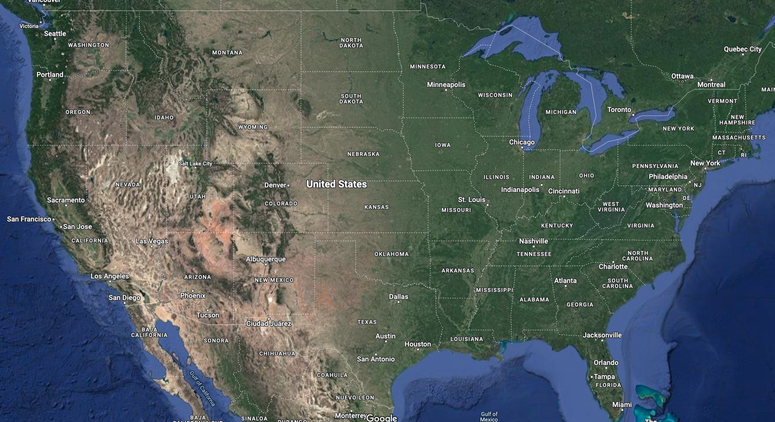
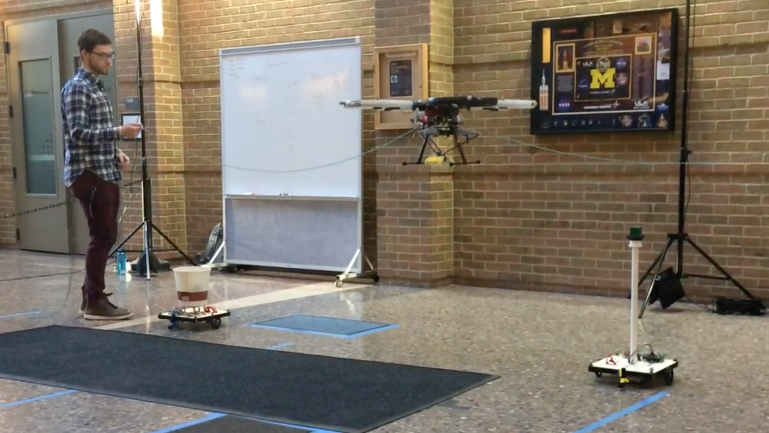
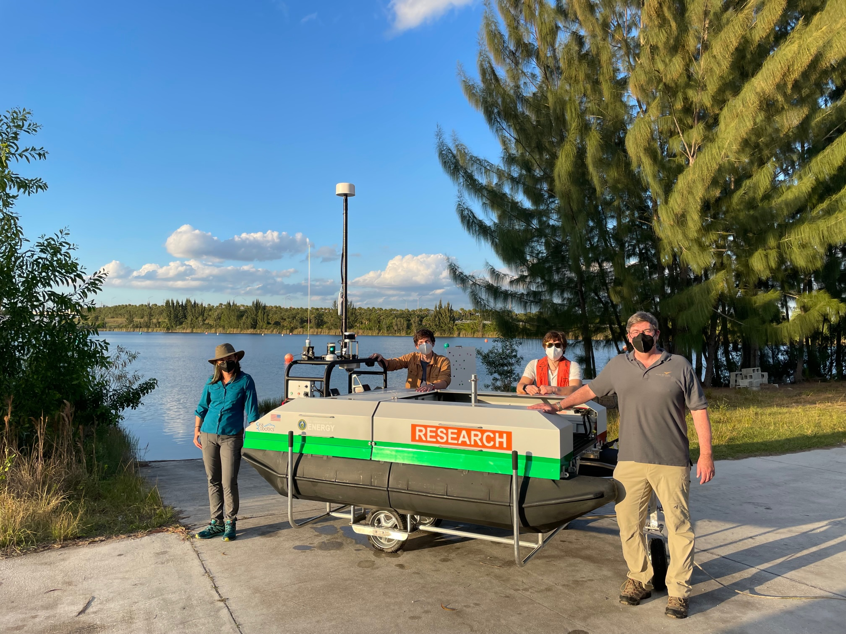
About me
Sequim
Richland
Ann Arbor
Cleveland
San Antonio
BS Electrical Engineering
Minors in Spanish, History, Physics
Staff Research Engineer
MS Robotics
Machine Learning Researcher
Marine Robotics Researcher

Slide 5
About Pacific Northwest National Lab (PNNL)
An overview of the lab and its operations

Slide 6
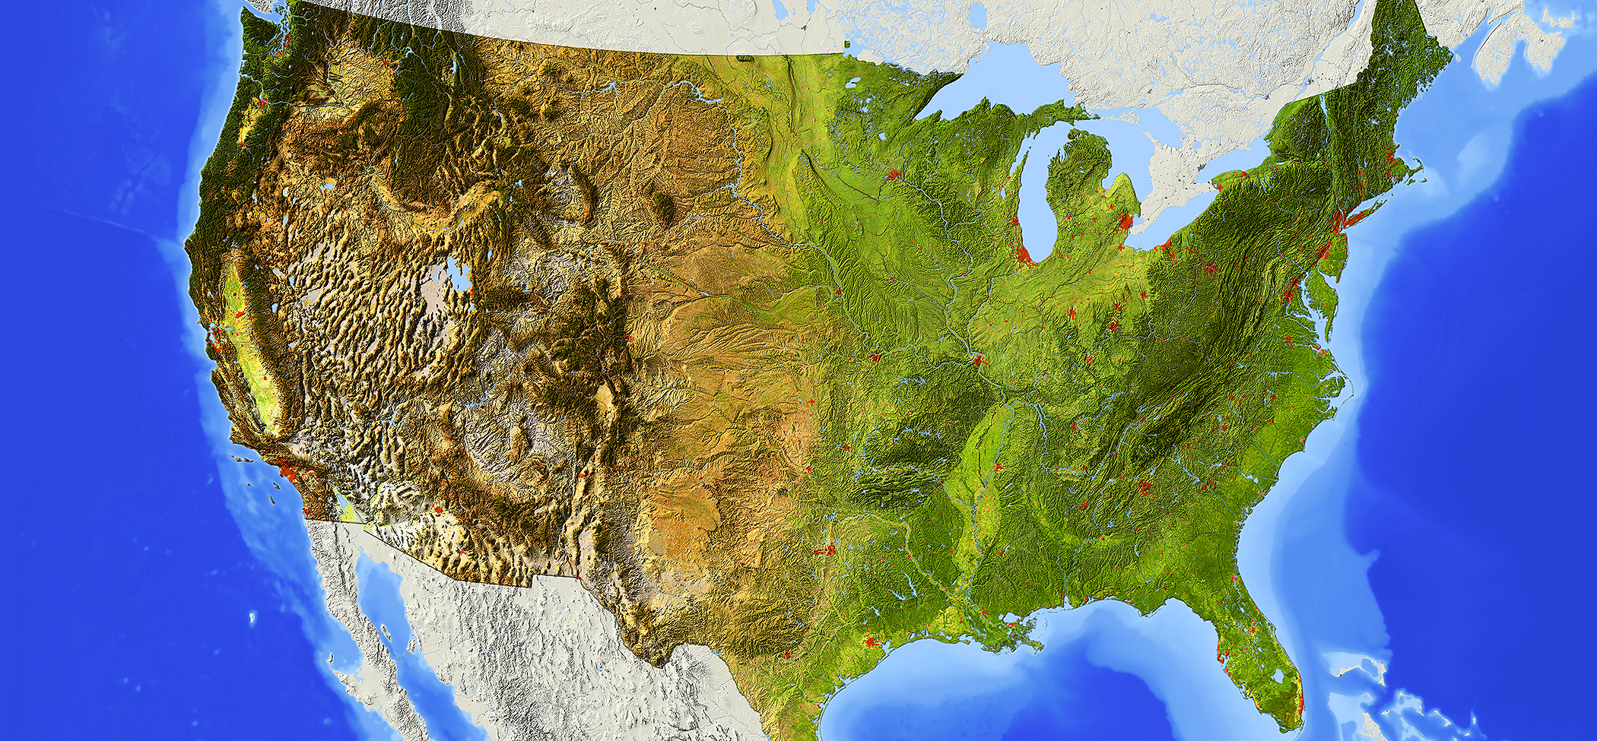

















DOE’s 17 national laboratories tackle critical scientific challenges
Notes:
OPTIONAL - for use with general audiences, those unfamiliar with the national laboratory system, and the community
DOE’s system of national laboratories grew out of the Manhattan Project, creating unprecedented science and technology capabilities required to design and build the first atomic bomb. Los Alamos, Oak Ridge, and Hanford (which later evolved into PNNL) were created to meet this initial mission. As DOE’s mission evolved, so did the network of labs.
Today, the DOE S&T complex consists of 17 labs located across the United States that support DOE’s missions in scientific discovery, energy, national security, and environmental stewardship. While each laboratory has its own unique scientific tools, facilities, capabilities, and projects, the national laboratories also engage in crosscutting science activities and collaborative projects that leverage their talents and assets. From basic research and scientific discovery to development and demonstration of advanced technologies and other innovations, these 17 world-class institutions constitute the most comprehensive research and development network of its kind.

Slide 7
Of which 9 are operated by Battelle Memorial Institute
Notes:
OPTIONAL - for use with general audiences, those unfamiliar with the national laboratory system, and the community
DOE’s system of national laboratories grew out of the Manhattan Project, creating unprecedented science and technology capabilities required to design and build the first atomic bomb. Los Alamos, Oak Ridge, and Hanford (which later evolved into PNNL) were created to meet this initial mission. As DOE’s mission evolved, so did the network of labs.
Today, the DOE S&T complex consists of 17 labs located across the United States that support DOE’s missions in scientific discovery, energy, national security, and environmental stewardship. While each laboratory has its own unique scientific tools, facilities, capabilities, and projects, the national laboratories also engage in crosscutting science activities and collaborative projects that leverage their talents and assets. From basic research and scientific discovery to development and demonstration of advanced technologies and other innovations, these 17 world-class institutions constitute the most comprehensive research and development network of its kind.

Slide 8
PNNL’s Mission
Reinventing Chemical Conversions and Energy Storage Materials
Understanding Multiscale Earth Dynamics and the Role of Coastal Systems
Understanding, Predicting, and Controlling the Phenome
Scalable Machine Reasoning for Scientific Discovery
Energy Decarbonization through Grid Control and Energy Storage
Accelerating Development and Characterization of Nuclear Material Processing

Slide 9
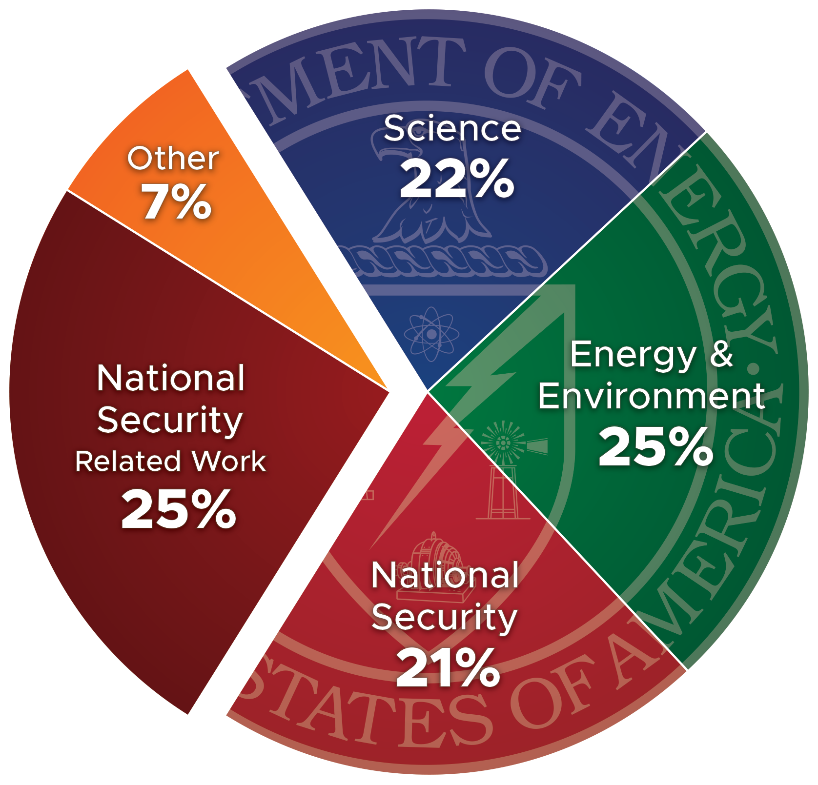




PNNL is DOE’s most diverse national laboratory
5,300
Staff
$1.24B
Spending
1,755
Peer-reviewed
Publications
247
Invention
Disclosures
FY 2021 Staff
Notes:
OPTIONAL - Alternate view: this pie chart shows sponsor breakdown by staff
In FY 2021, PNNL had $1.34 billion in funding (or sales) and $1.24 billion in spending (or business volume). The pie chart reflects the distribution of FY 2021 staff or full-time equivalents (FTE) by sponsor.
Source for this data: PNNL Fast Facts in Insight. These numbers are updated annually at https://enterprise.pnl.gov/sites/LPPM/LPPM%20Documents/Insight_master_files_/PNNL_Fast_Facts.pdf.
In addition to the numbers shown on the slide, PNNL generated more than $1.59B of economic output and supported more than 7,500 jobs in Washington state in FY 2020. The number of jobs supported by PNNL includes those we hire directly, plus jobs created by the goods and services that we purchase. Source: FY 2020 Economic Impact Report (https://www.pnnl.gov/economic-impact). The FY 2021 updates to these figures are not yet available.

Slide 10
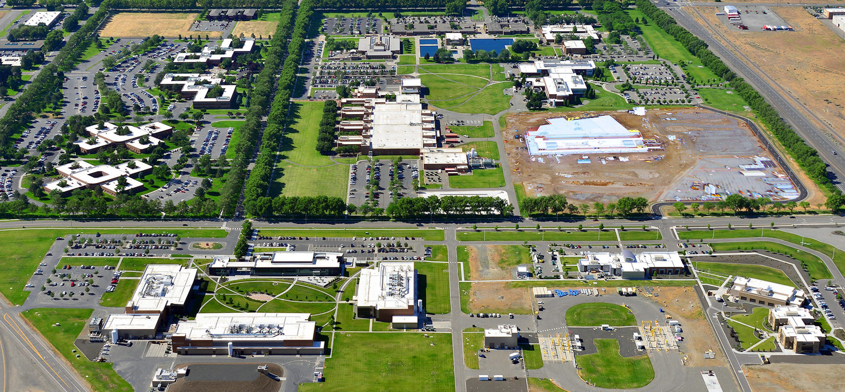
A regional, national, and international scientific resource
Energy Sciences Center
DEDICATED FALL 2021
FUTURE HOME OF
Grid Storage Launchpad
Notes:
OPTIONAL - for use with general audiences, those unfamiliar with the national laboratory system, and the community
PNNL is a national lab with Pacific Northwest roots and global reach. Whether our researchers are unlocking the mysteries of Earth’s climate, helping modernize the U.S. electric power grid, or safeguarding ports around the world from nuclear smuggling, we accept great challenges for one purpose—to create a world that is safer, cleaner, more prosperous, and more secure.
Founded in 1965, PNNL is operated by Battelle for the U.S. Department of Energy's Office of Science. DOE's Office of Science (https://www.energy.gov/science/office-science) is the single largest supporter of basic research in the physical sciences in the United States and is working to address some of the most pressing challenges of our time.

Slide 11
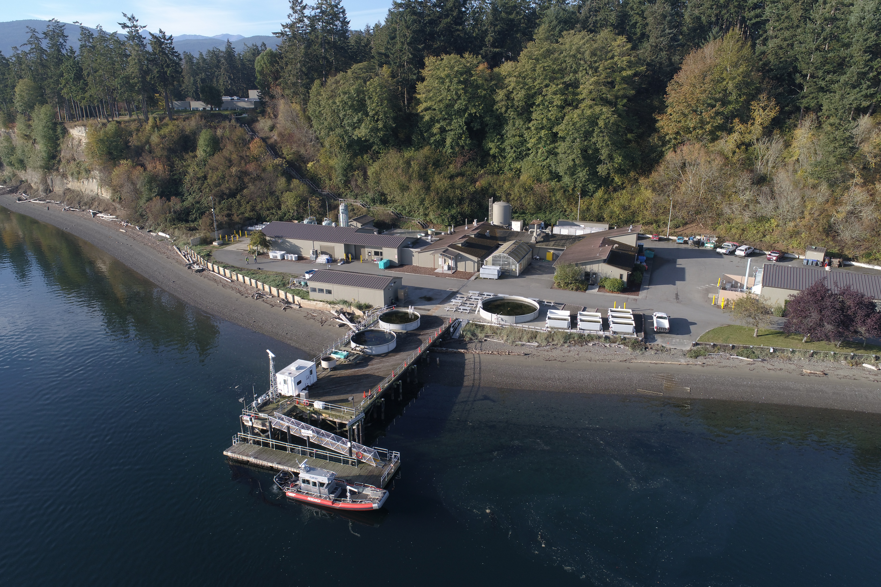
Marine and Coastal Research Lab at PNNL Sequim
.
Notes:
PNNL’s Sequim Campus is home to the Marine and Coastal Research Laboratory, DOE’s only dedicated marine sciences laboratory, serves DOE and its partners to unlock the potential of ocean renewable energy to advance energy system resilience, support equitable economic development, ensure healthy coastal ecosystems, and propel the Nation towards meeting 2035 and 2050 climate goals.
Campus location allows us to go from bench to bay to enable research. The shoreline adjacent to our facilities enables us to extend our research scope to include a “living laboratory”
The pier, floating dock, and research vessels enable us to have ready access to PNNL’s tidelands and extended research areas in Sequim Bay.

Slide 12
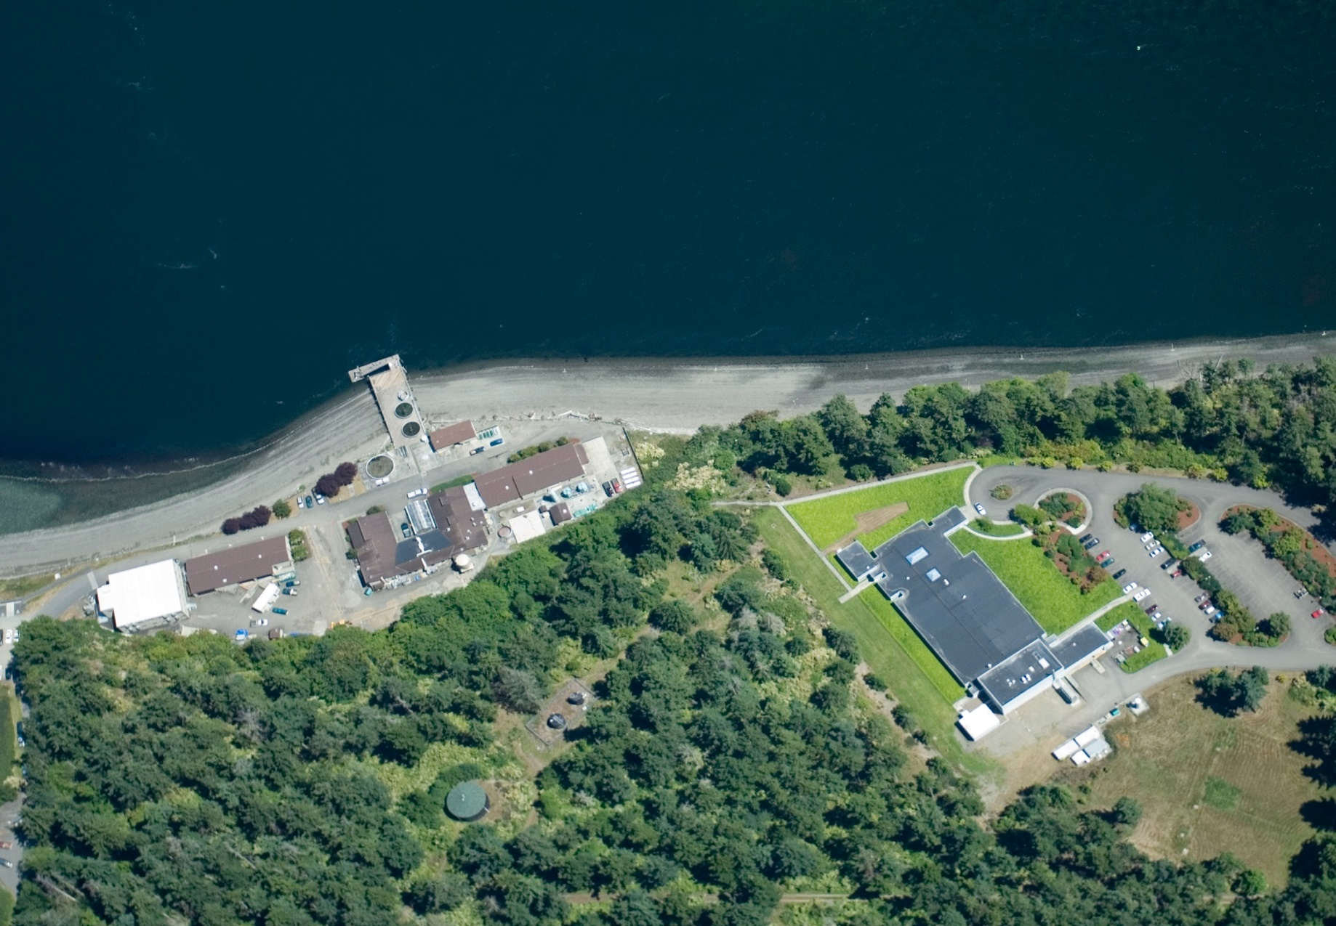




Research
Campus
15,000 ft² of analytical, electronics, biotechnology, and aquatics laboratories supplied with heated and cooled freshwater and seawater
MSL-1
MSL-2
MSL-7
MSL-5
10
Facilities and structures
117
Acres DOE-owned
(140 acres currently Battelle-owned)
5000
Acres submerged
80+
Staff and researchers
Notes:
The campus builds on a rich history of research related to marine and coastal resources and is divided between two areas, the shoreline facilities located directly on the water, and the uplands located 100 feet above sea level. Separate vehicle access routes and a pedestrian pathway with stairs connect the two distinct areas. Development in the shoreline area is limited to vertical growth, whereas the uplands area with the heavily forested and sloping terrain provides development around the existing facilities. The PNNL Marine Sciences Laboratory has the ability to increase the facility footprint by 81,000 gross square feet (GSF) (from 51,000 GSF to 132,000 GSF) with the majority of the buildings housed in the uplands area.
The location offers a wide range of tidal conditions, in some areas greater than 3 meters with river flows ranging up to 350 cubic meters per second. These conditions offer benefits to the tidal-energy conversion device research and coastal resilience modeling. In addition, the salinity and quality of water in Sequim Bay resemble a largely pristine coastal ocean rather than a typical estuary due to a combination of relatively low rainfall and a very small, largely forested watershed.
Battelle is transferring a portion of the 140 acres of tidelands and uplands to DOE, which allows the federal government to advance the marine and coastal research areas. Per the current DOE prime contract with Battelle Memorial Institute (DE-AC05-76RL01830), 117 acres of land and tidelands at the PNNL Sequim Campus will transition to federal ownership on or before October 1, 2022.
Portions of the campus have been set aside as No Activity Zone and a No Development Zone, an agreement with the Pacific Northwest Site Office and the Jamestown S’Kallam Tribe. Non-invasive research (e.g., instrumentation) may continue in the No Development Zone through case-by-case permits.
Sequim Bay is a 5,000 acre, 126-foot-deep, submerged glacial valley off the Strait of Juan de Fuca providing researchers opportunities to study the effects of tides, upstream dynamics, and biogeochemical activities.
PNNL Sequim serves as a focus for research by staff from across PNNL and the outside research community who need occasional access to the campus resources and expertise. On average, approximately 80+ staff and researchers use the facilities, site, and location to conduct research to further the national mission.
Facility and Structure Info*
MSL1: 7,754sf lab space, Flow-through aquatics, electronics, ultra trace radiological, BSL-1 labs
MSL1G: 792sf storage
MSL1W: 280sf common
MSL2: 1,847sf lab space, BSL2 labs
MSL3: 489sf storage
MSL4: 100sf common
MSL-5: 7,334sf lab space, Biofuels, Ultra trace chemistry
MSL-7: 5,341sf Offices
Boat ramp, pier and
floating dock
*as of June 2020 the laboratory name changed from Marine Sciences Laboratory to Marine and Coastal Research Laboratory (MCRL) and will in time change the building names to reflect the new name
Staff & researchers as of May 2020
54 onsite permanent staff
10 temp students
~30 visiting researchers
20 positions open

Slide 13
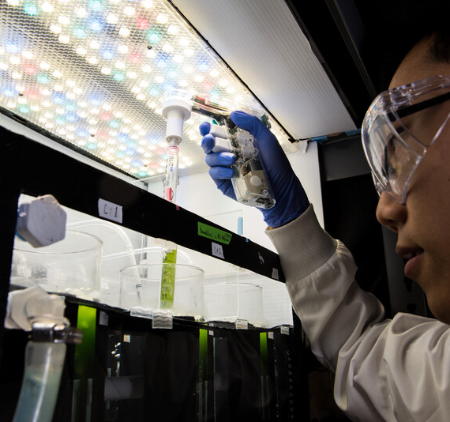
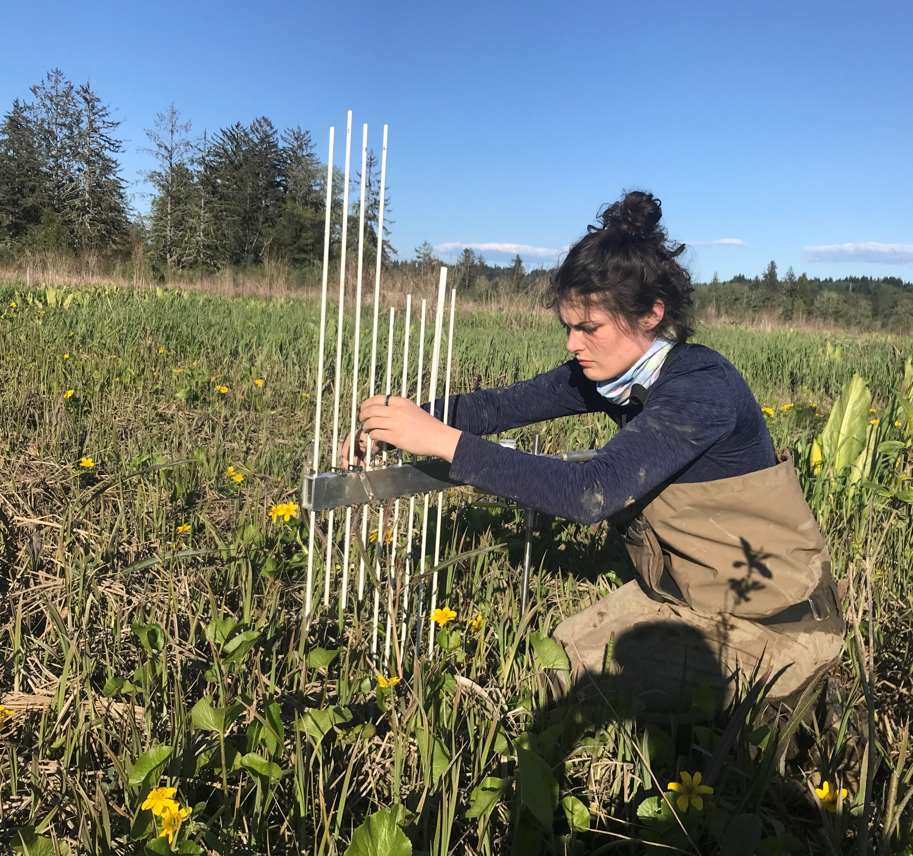
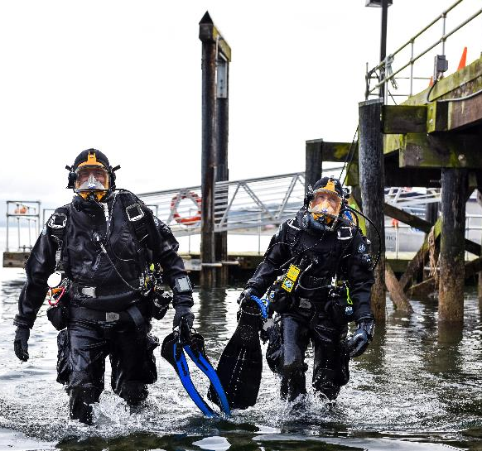
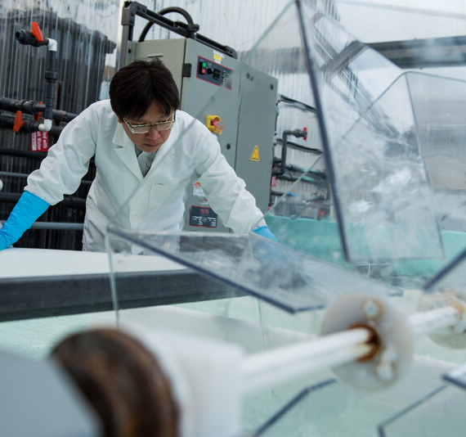
Marine and Coastal Research and Capabilities
70+ research scientists
Disciplines: ecology, marine biology, oceanography, biogeochemistry, marine engineering, coastal modeling
Research focus areas: habitat restoration, coastal and aquatic ecology, bioenergy, analysis of metals and organics, earth system models and environmental monitoring
Notes:
There are over 70 scientists that are working on marine and coastal research associated with the Sequim campus.
We are a technically diverse group. Our scientist include biologists, ecologists, engineers and chemists.
We work study habitat restoration of coastal ecosystems, engineer biofuels from algae, analyze samples for metals and organics to understand pollutants in the environment, build and run earth system models to evaluate climate change, and design experiments to study environmental conditions in marine and coastal areas.
CSD Teams:
- Biogeochemistry team – mineral extraction, carbon cycling for earth system models
- Ecosystem team – large scale habitat restoration; underwater and in coastal habitats
- Coastal Modeling – using models to understand natural hazards ( hurricanes or tsunamis) and placement of critical infrastructure along coastlines
- Marine Technology – developing and enabling marine technology for variety of purposes including environmental monitoring around MRE
- Bioenergy – Improve the economics of using microalga biofuels by identifying fast growing strains and their growth performance
- Coastal Ecosystems – studies area to better understand Interactions between biological and physical environments to inform decision making related to coastal processes
- Offshore Wind and Ocean Dynamics team supports national offshore wind deployment goals by understanding wind/wildlife impacts, studying climate and coastal ocean dynamics, and developing technologies to support site characterization.

Slide 14
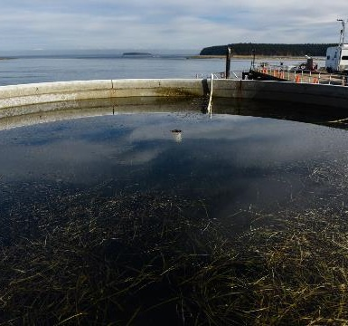
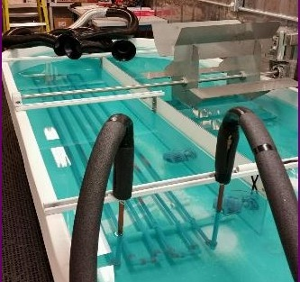
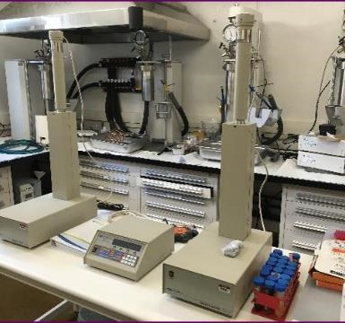
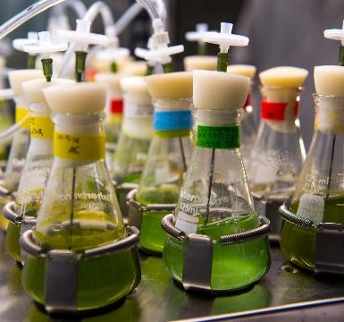
Research Facilities
15,000 sq. ft. of laboratories
Seawater and freshwater labs
BSL2 molecular microbiology and toxins labs
Arctic research labs
Isolation labs
Marine mesocosm tanks
Marine mesocosm tanks
1100 L circulation tank for generating Frazil sea ice
Hyperbaric laboratory
Algal culture laboratory

Slide 15
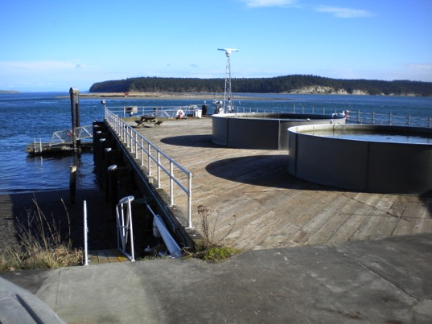
Outdoor Capabilities
Meteorological station
Water level recorders
Survey levels and equipment
Outdoor experimental tanks
Anechoic tank
Wet and dry lab facilities
Ambient seawater delivery system
Deep artesian freshwater well
Waste water treatment system
Notes:
An anechoic chamber is a room designed to completely absorb reflections of either sound or electromagnetic waves. They are also often isolated from waves entering from their surroundings. This combination means that a person or detector exclusively hears direct sounds, in effect simulating being inside an infinitely large room

Slide 16
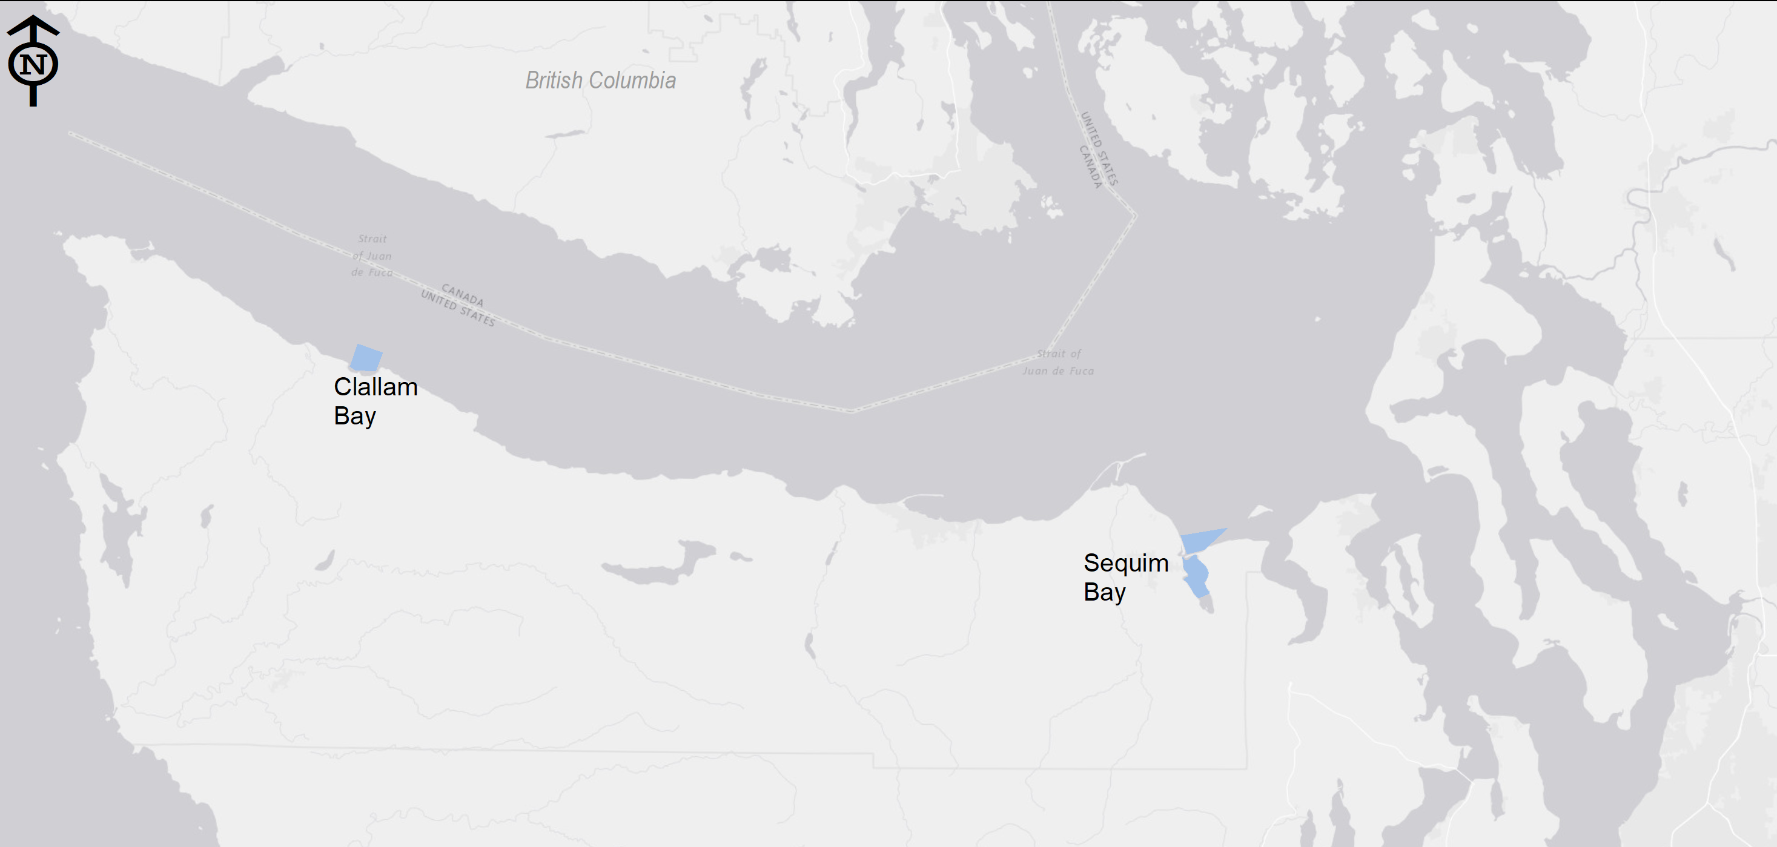
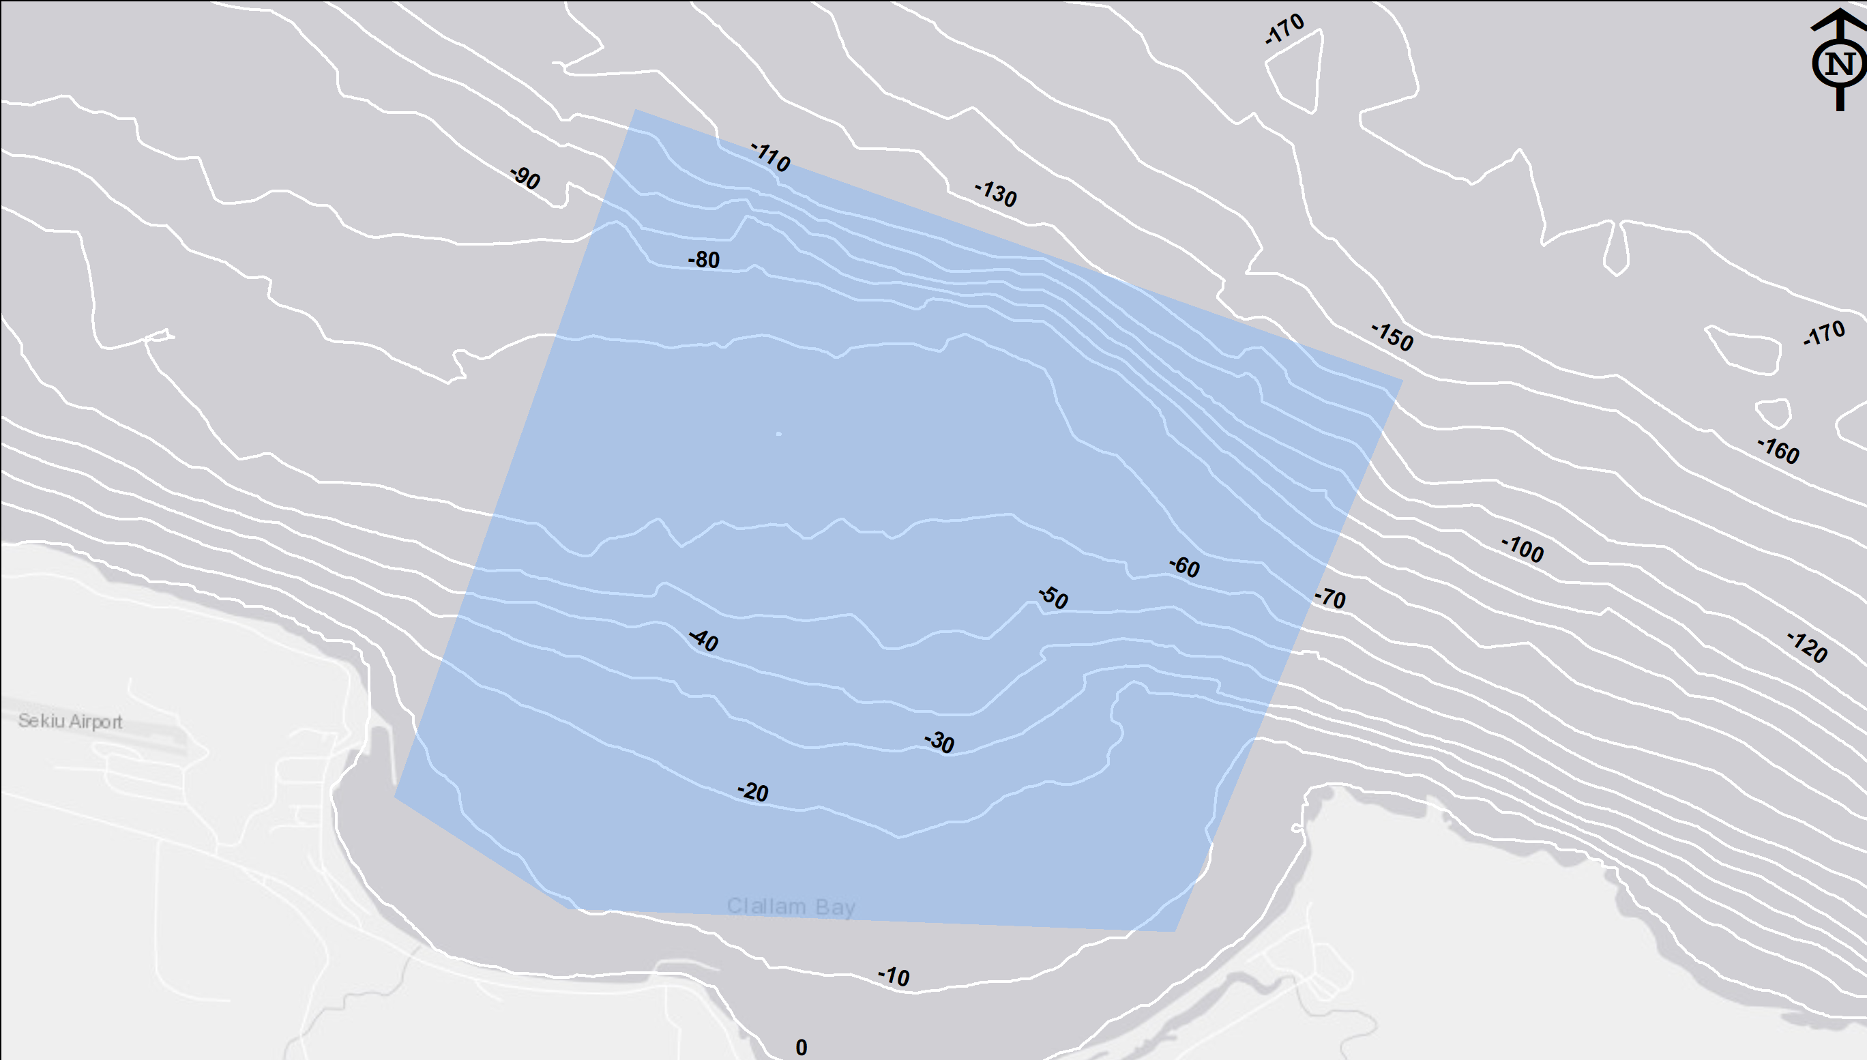
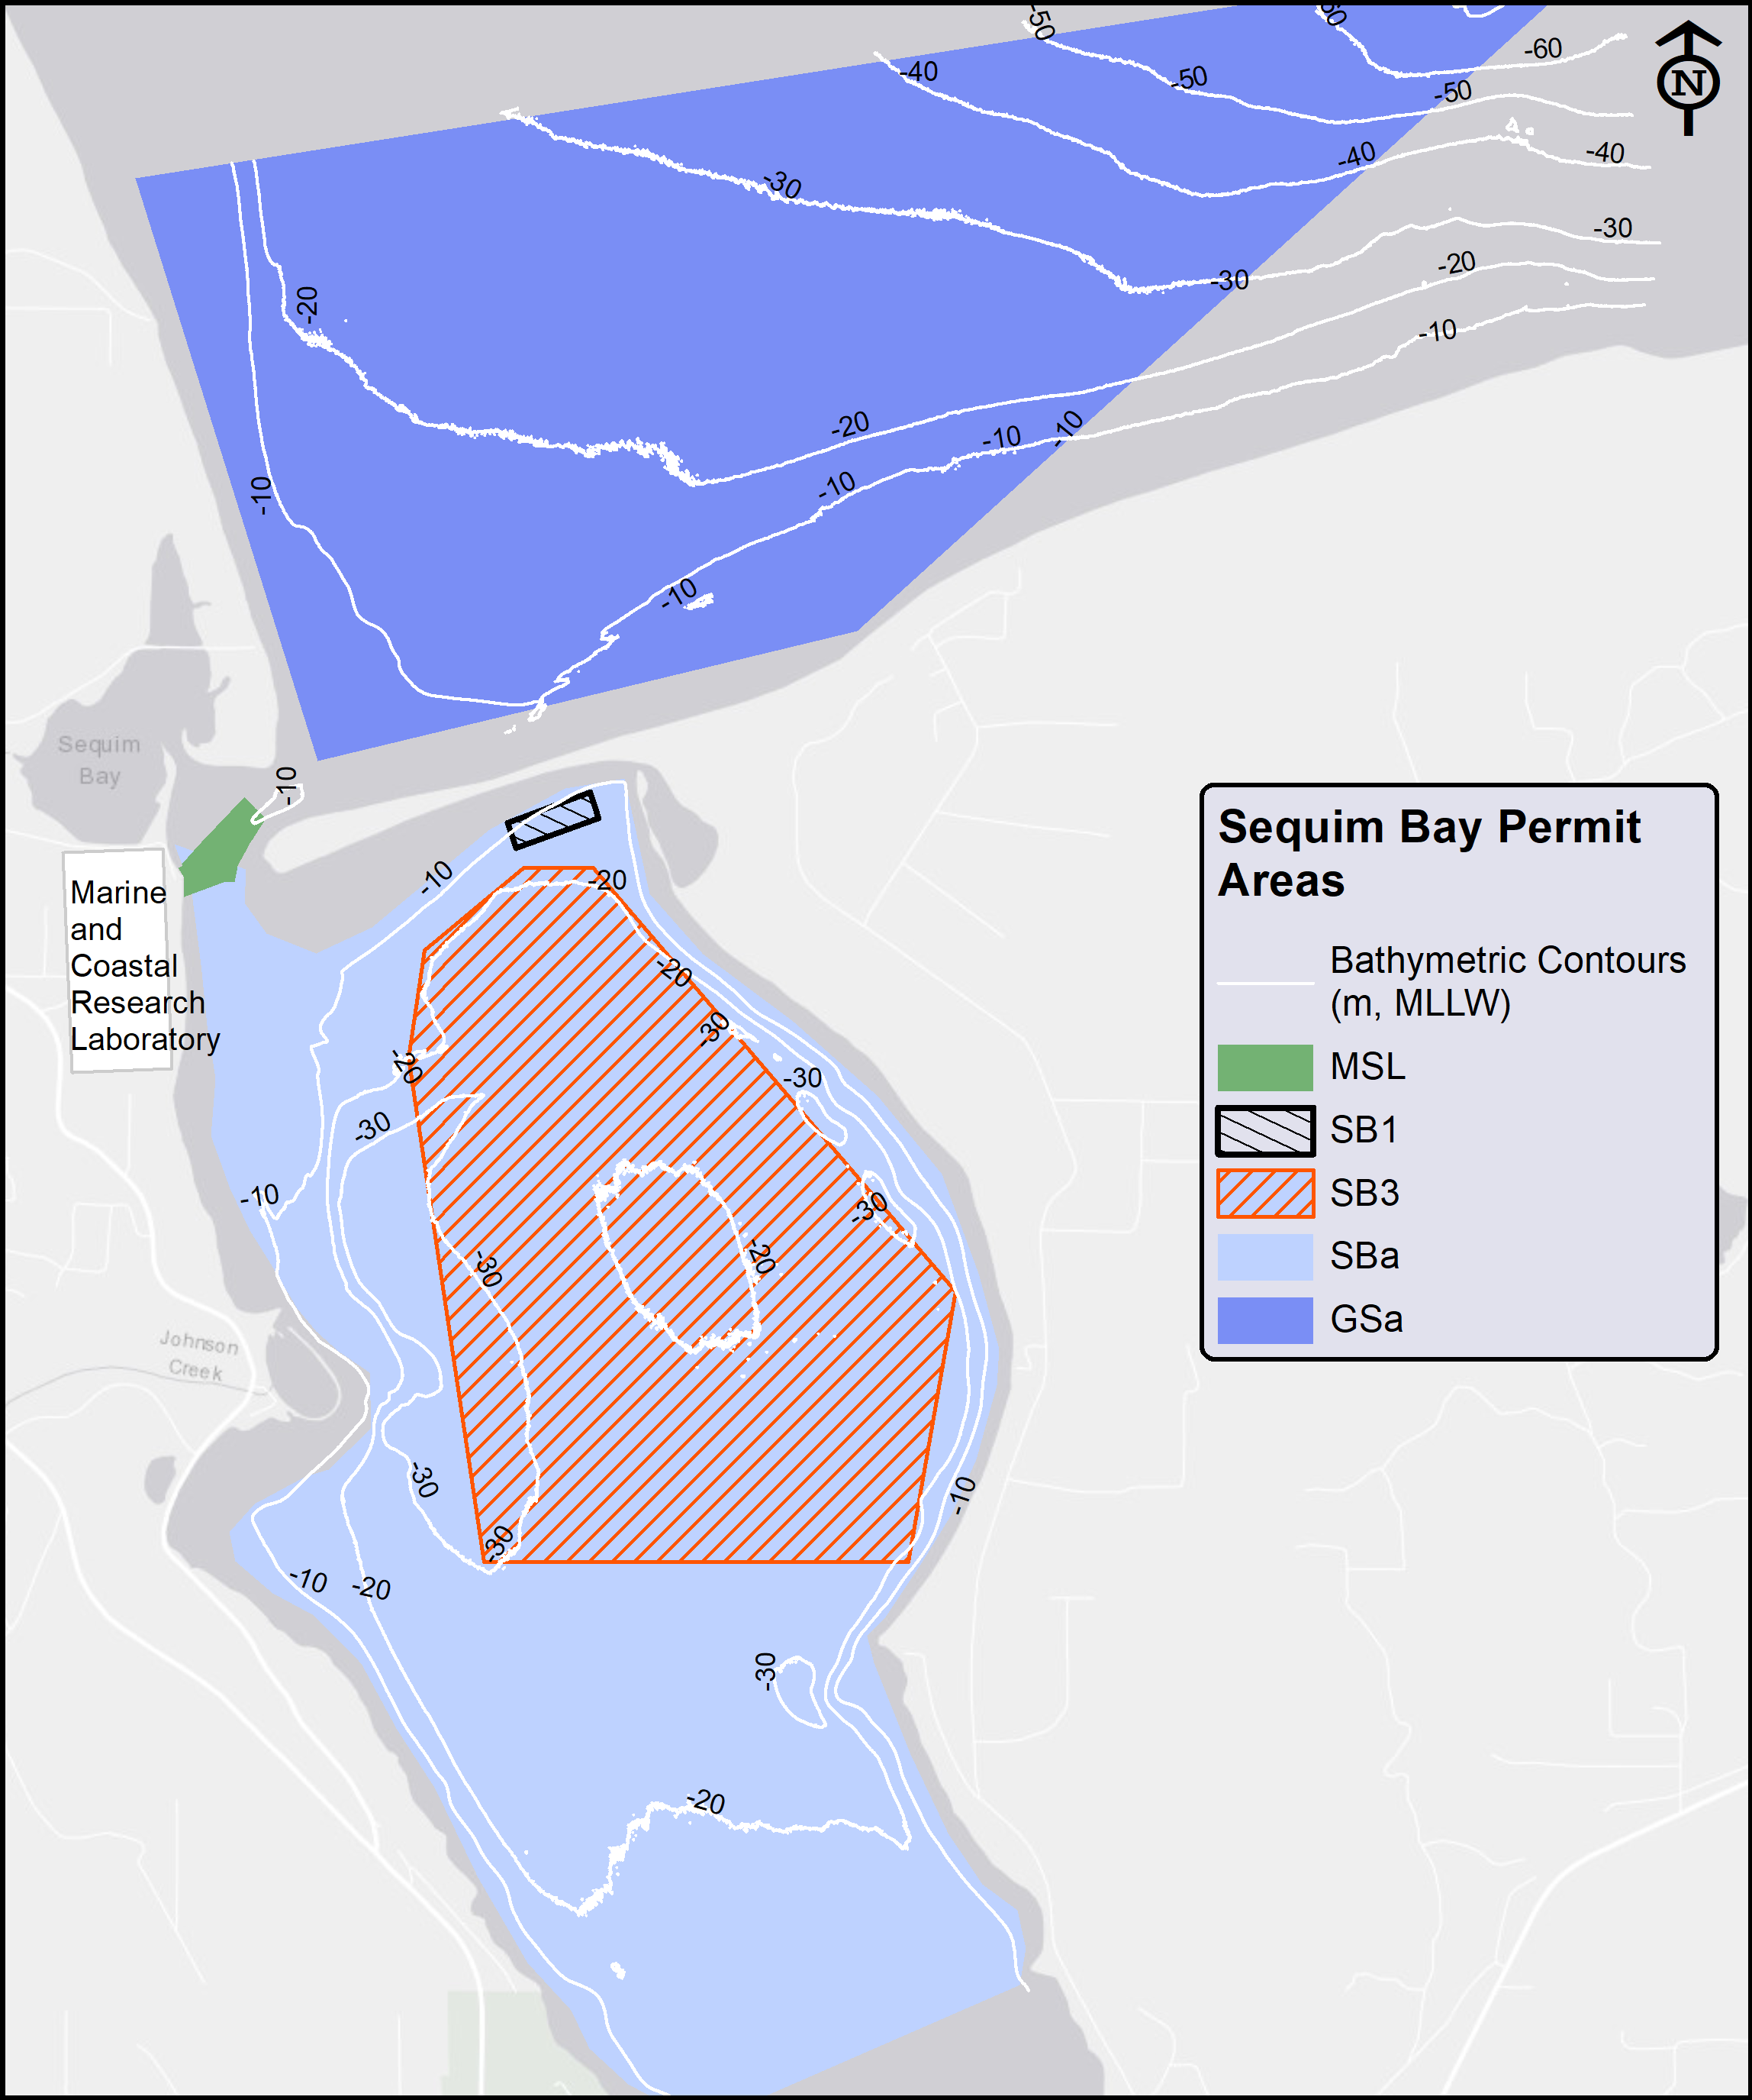
Permits within Sequim and Clallam Bay
Notes:
There is a 5-year blanket permit in Sequim and Clallam Bay allowing flexibility to conduct experiments without delay. Projects can go in and out of the water within a day because of the permit type. PNNL can perform most of the research activities in Clallam Bay, east of Neah Bay, that can be conducted in Sequim. Research such as seabed installations, acoustic operations, autonomous underwater vehicles, surveys and sediment sampling are some examples. The permits expand the geographic extent of research and allow access to different marine conditions. Sequim Bay is quiescent, while Clallam Bay is more exposed, giving rise to more diverse environmental conditions and offering a suite of conditions for testing and experimentation.
MSL = the polygon closest to the Marine and Coastal Research Laboratory pier
SB1 = Sequim Bay 1. The smallest box just south of Travis Spit
SB 3 = Sequim Bay 3. The largest box (in yellow) in Sequim Bay
SBa= the large blue polygon inside of Sequim Bay
GSa = an old name short for Gibson Spit a; “a” stands for “acoustic”.
The large blue polygons on the Sequim Bay map indicate areas where we can perform acoustic activities.
Two permits are currently in progress, Dungeness and a tidal energy permit to further expand the research capacity.
Other Permit Notes as of May 2020
the suite of blanket permits for Sequim Bay will begin expiring in early 2021, though PNNL is currently working to obtain renewals.
The specific projects/activities still need to go through internal review by the various Subject Matter Experts (cultural, biological, NEPA, and environmental research permitting) on a case-by-case basis to formally determine the applicability of the blanket permits. (These permits and authorizations have specific parameters that must be followed.) Careful coordination between the researchers and regulatory SMEs is necessary during project planning

Slide 17
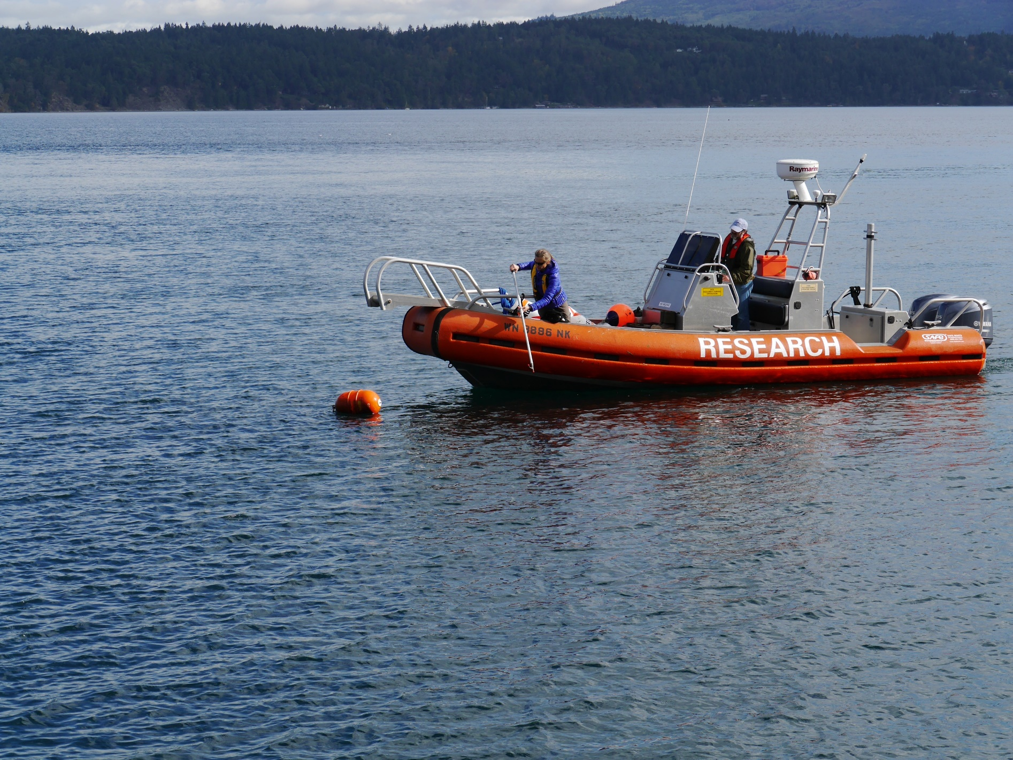
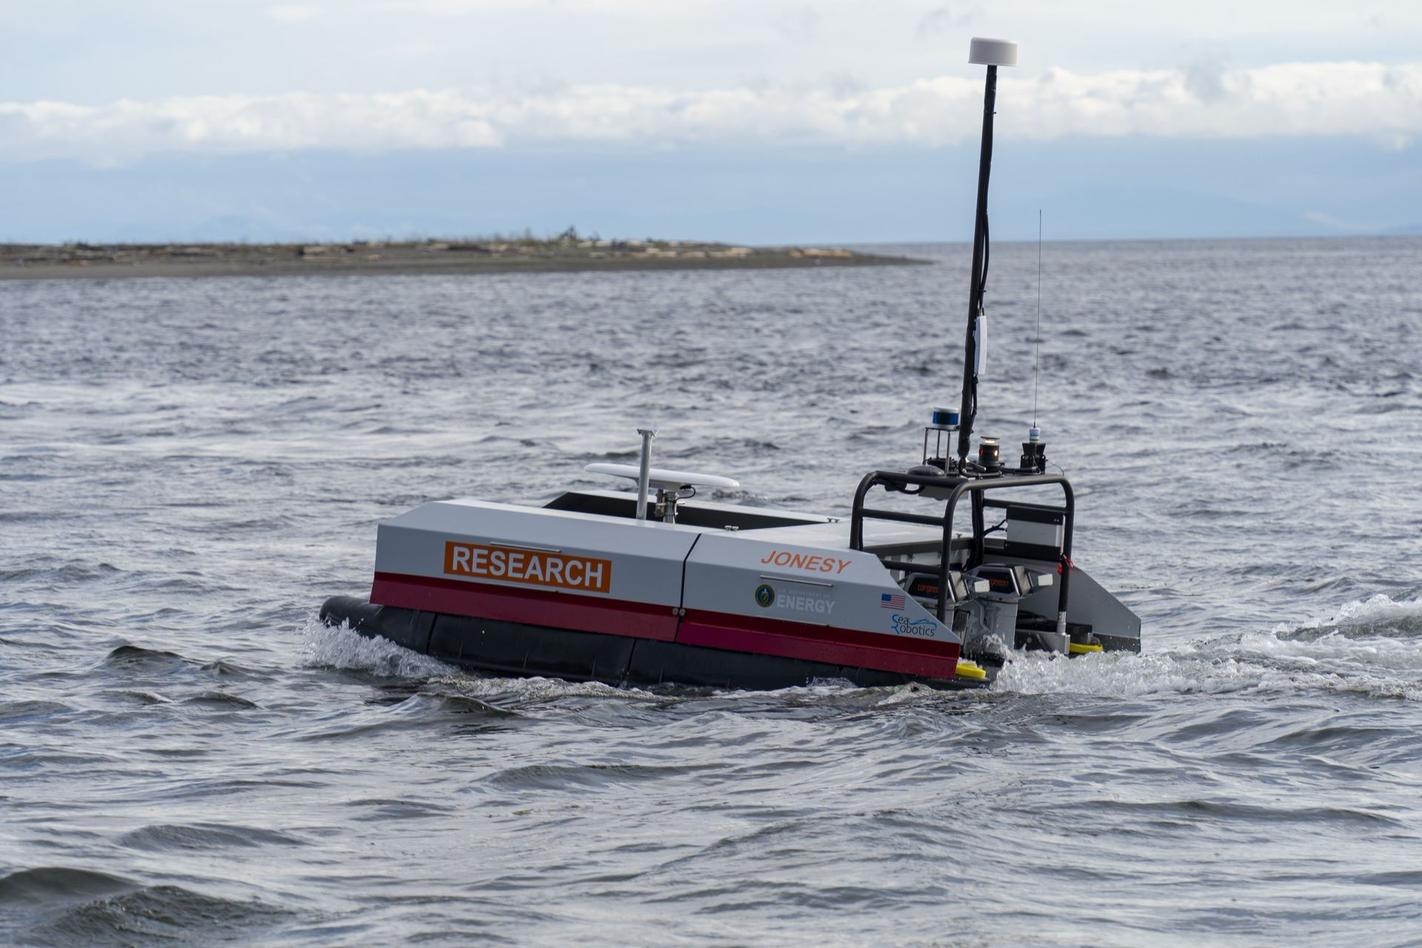
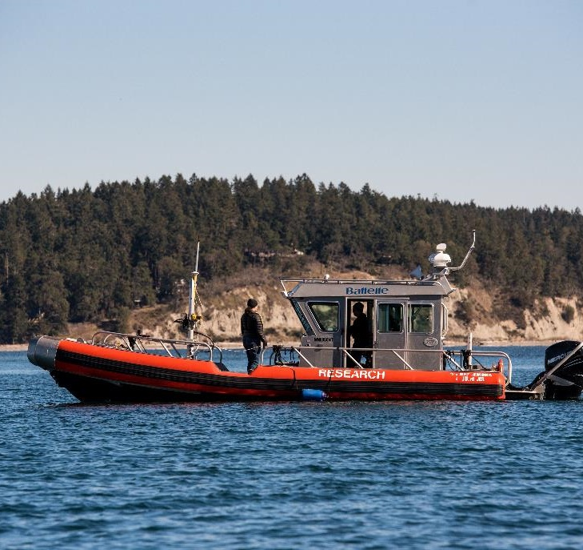
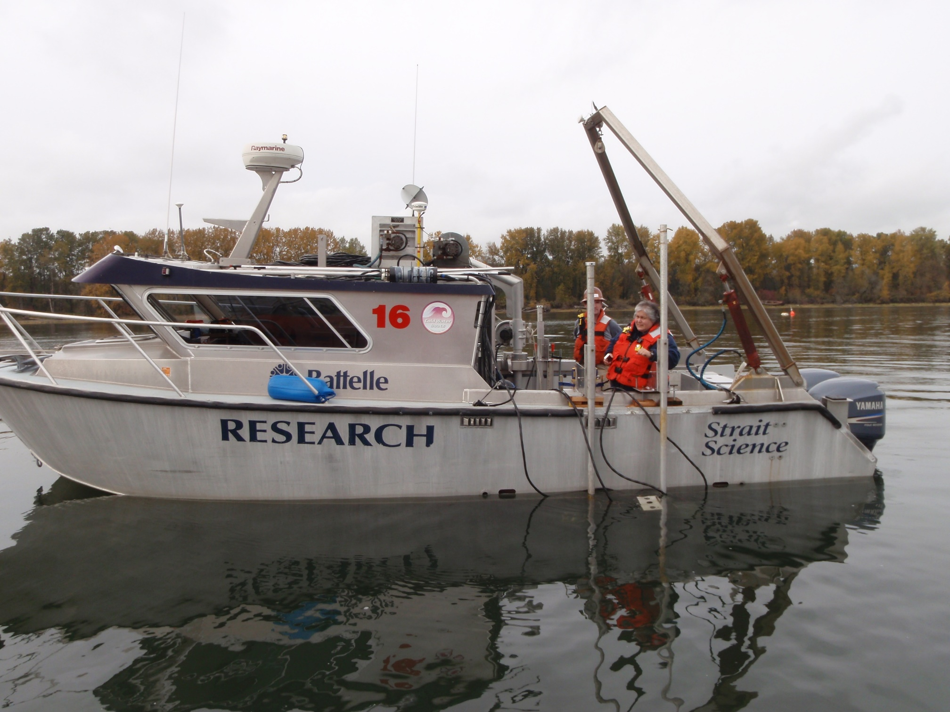
Vessels
Notes:
33-ft SAFE Boat with davit and optional gantry system (Desdemona)
Sensor deployment and retrieval
Test vessel for law enforcement training and NSD activities
28-ft Aluminum vessel with A-frame and davit (Strait Science)
Sensor deployment and retrieval
Test vessel for law enforcement training and NSD activities
23-ft SAFE Boat (SAFE Boat)
Lightweight sampling and sensor gear
Can access smaller and shallower bodies of water
17-ft- Alumaweld Super-Vee LS (Tenacious-A)
Shallow habitat sampling
Beach seining, surveying, and marsh research
Sun Tracker 20 Fun Fish (Sun Tracker)
Testing platform for equipment testing
On-site floating laboratory
M/V Robertson (leased from UW)
Deployment and retrieval of heaver equipment than can be deployed from the Strait Science

Slide 18
Artificial Intelligence (AI)
A history of and introduction to AI

Slide 19
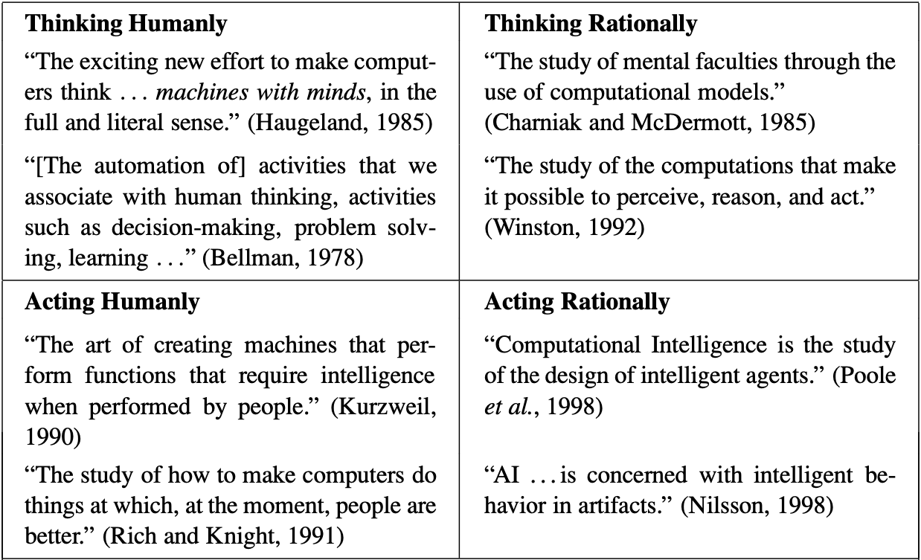
Definitions of Artificial Intelligence
Russell and Norvig: Artificial Intelligence: A Modern Approach. 2010
Notes:
Start with intimidating table of text with choice definitions of AI
- Captures the forces at play: is it about thinking or acting? Is it about being as good as humans, or been perfectly logical (rational)?

Slide 20

Foundations of AI
Pillars of AI:
Artificial Intelligence
Philosophy
Economics
Neuroscience
Computer Engineering
Linguistics
Control Theory
Mathematics
Psychology
Notes:
There’s no clear definition in part because so many people and fields contribute to AI
Aristotle – formal logic through syllogisms in 350BC
Golgi – study of neurons 1900’s
Cognitive psychology – 1950s
Von Neumann – decision theory 1950s
I’d argue it’s a central question to humanity:
How does X work
Can I make X?
Where humanity itself is the most complex thing we can think of (but also could it be better than us?)

Slide 21
A Timeline of AI
Deep Neural Networks become state of the art
Multi-layered Perceptron is invented
Neural Networks are invented
Backpropagation is invented
Nearly all British government funding for AI research is cut
DARPA Grand Challenge ushers in AVs
Dartmouth Workshop
Shakey the robot
All US gov. funding for machine translation is cut
Bayesian NNs are invented
Support Vector Machines are invented
1956
1967
1986
2012
The “Look, ma, no hands!” era
“The vodka is good but the meat is rotten”
“AI is the new electricity.”
AI Winter
Notes:
Russian translation of biblical phrase “the spirit indeed is willing, but the flesh is weak” -> “the vodka is good but the meat is rotten”

Slide 22
So what is AI?
Knowledge Representation
Planning
Deduction, Problem Solving
Perception and Computer Vision
Artificial Intelligence
Social Intelligence
Machine Learning
Natural Language Processing
Robotics

Slide 23
So what is AI?
Knowledge Representation
Planning
Deduction, Problem Solving
Perception and Computer Vision
Artificial Intelligence
Social Intelligence
Machine Learning
Natural Language Processing
Robotics

Slide 24
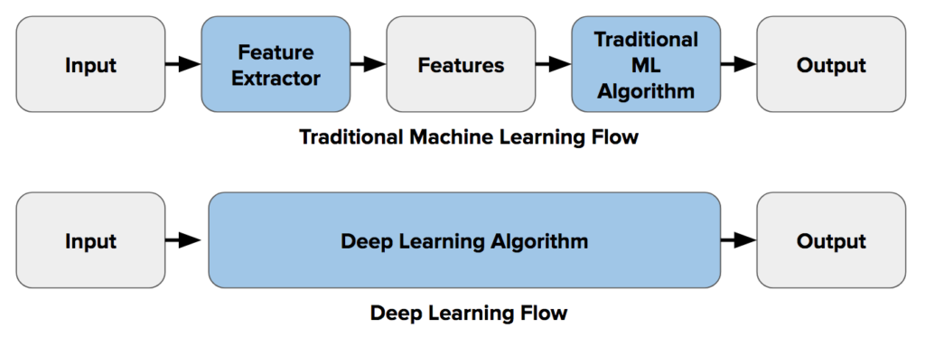
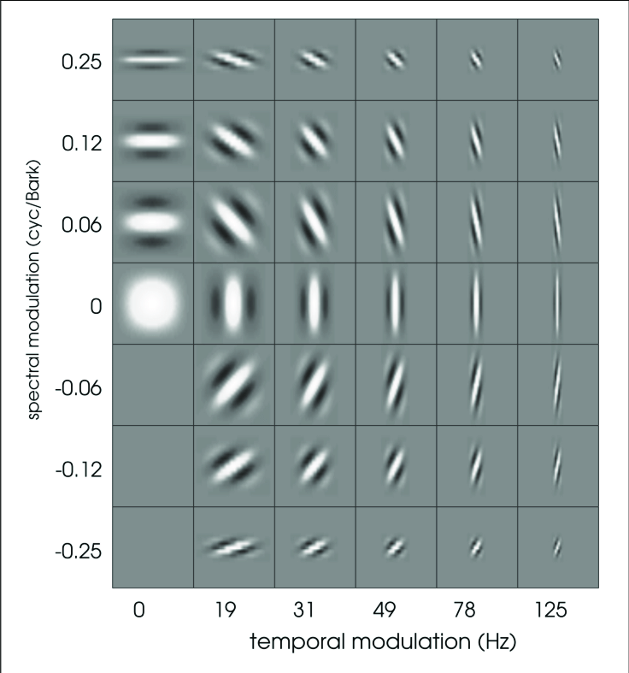
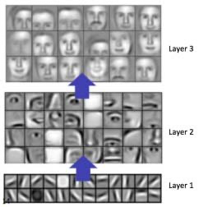
Why AI is Hot
Something called Deep Learning has broken prior barriers in AI

Slide 25
Artificial Intelligence
Artificial Intelligence
Machine Learning
Deep Learning
Notes:
Artificial Intelligence as a field has been around the longest. Refers to anything that allows a compute to mimic a human. This can be machine learning or logic, association rules, decision trees, etc.
Machine Learning using statistical techniques where computers can improve with experience / more data
Deep Learning allows for hierarchical representations of data where the algorithm learns both the output and the features themselves

Slide 26
Machine Learning
“[ML uses] algorithms and statistical models to analyze and draw inferences from patterns in data”
(some) Popular Methods
  Linear-Logistic Regression
  Random Forests
  Support Vector Machines
  Bayesian Models
Artificial Intelligence
Machine Learning
Deep Learning
Notes:
Artificial Intelligence as a field has been around the longest. Refers to anything that allows a compute to mimic a human. This can be machine learning or logic, association rules, decision trees, etc.
Machine Learning using statistical techniques where computers can improve with experience / more data
Deep Learning allows for hierarchical representations of data where the algorithm learns both the output and the features themselves

Slide 27
Deep Learning
Subset of ML which extend previous neural network approaches, made applicable with the increase in available compute
Neural networks are made up of successive layers
“Deep” as in more layers
Artificial Intelligence
Machine Learning
Deep Learning

Slide 28
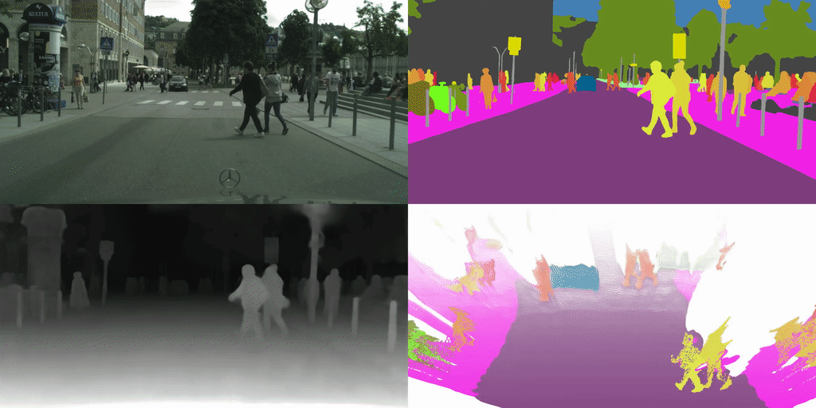
An Example – Semantic Segmentation

Slide 29
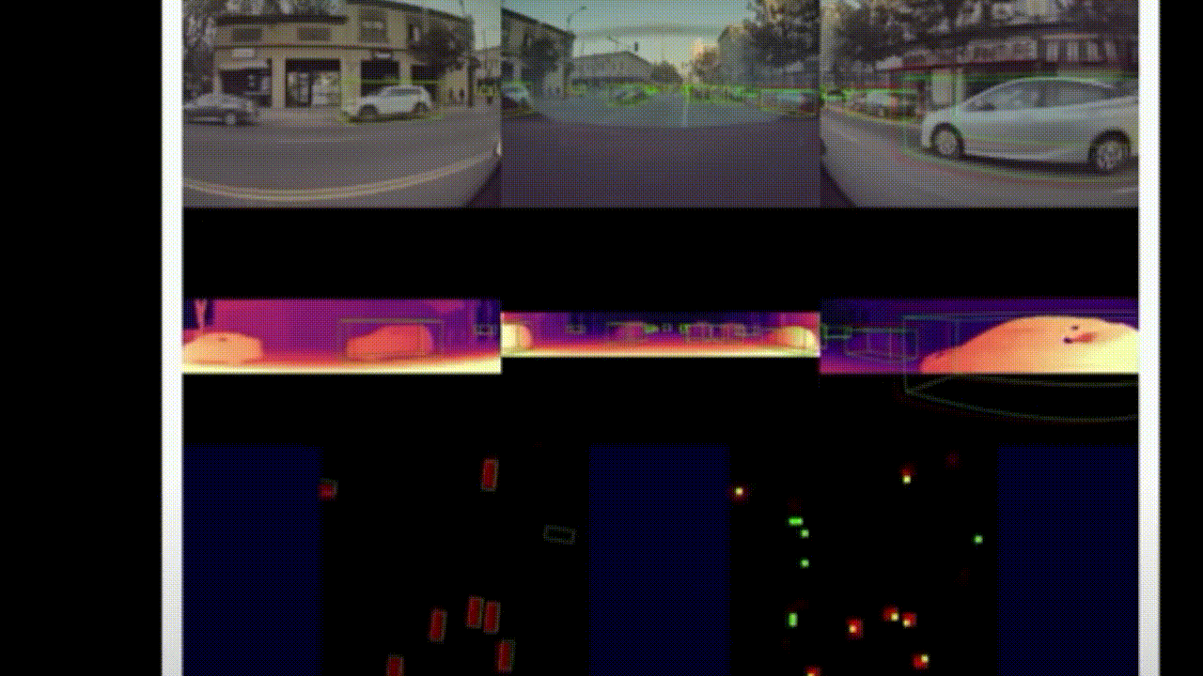
An Example – Autonomous Driving

Slide 30
Maritime Artificial Intelligence (AI)
Maritime AI at PNNL’s MCRL

Slide 31
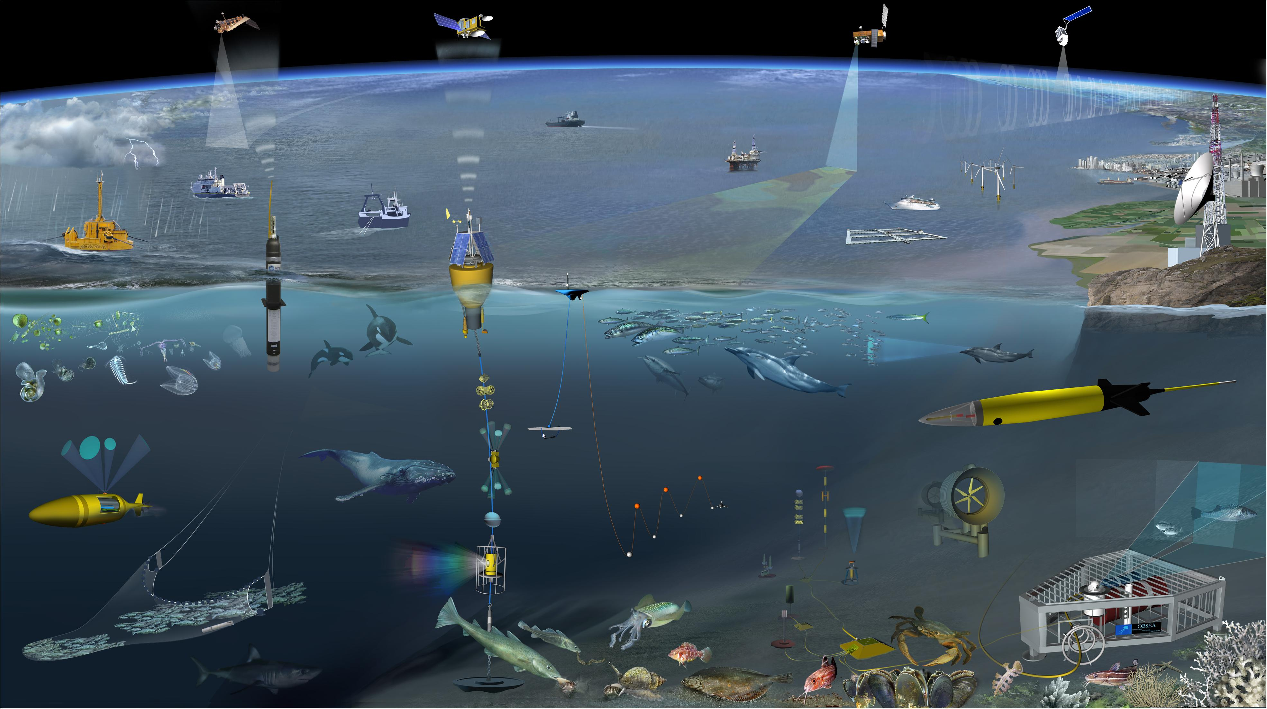
Overview of Maritime AI
Underwater mapping
Object Detection
Object Tracking
Multiple Sensor Aggregation
Autonomous navigation, motion, and planning
Autonomous and persistent exploration
Etc.
Notes:
Fish collision avoidance
Environmental monitoring
Environmental and weather modeling
Autonomous surveying, mapping, etc.
Renewable maritime power (wave energy converters, solar, wind, etc.)

Slide 32
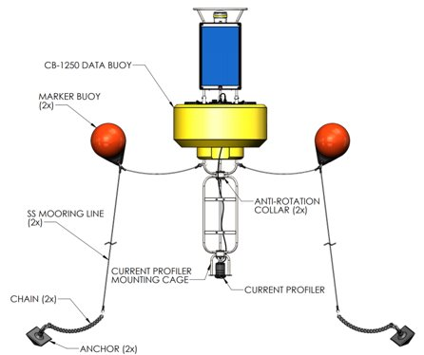
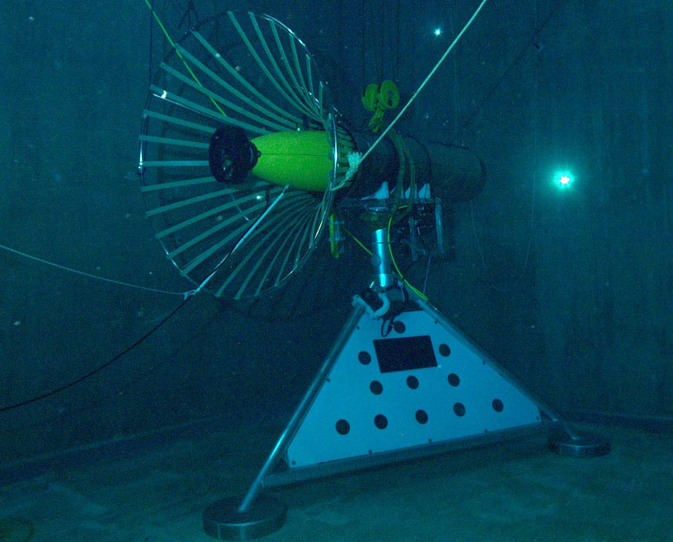

Autonomous Energy Harvesting
Renewable Energy Buoy
Autonomous Underwater Vehicle (AUV) docked
Autonomous Surface Vessel (ASV)

Slide 33
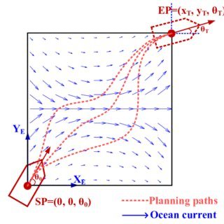
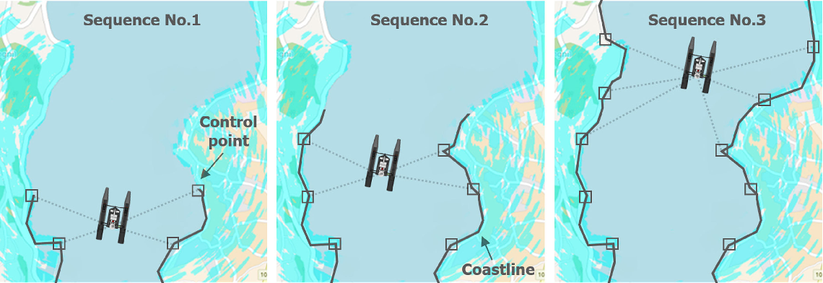
Autonomous Energy Harvesting
Simultaneous Localization and Mapping (SLAM)
Motion Planning and Control
Docking

Slide 34
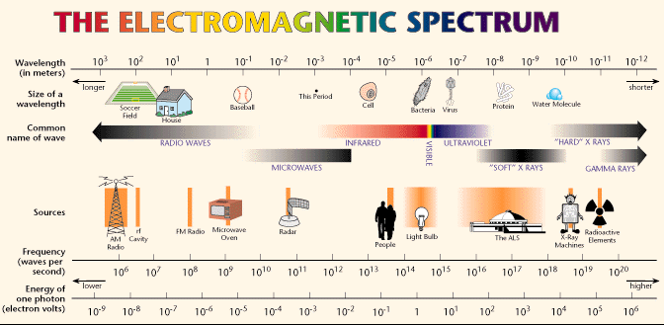
Eel Grass Detection, Mapping, and Monitoring
Underwater Acoustics
Images

Slide 35
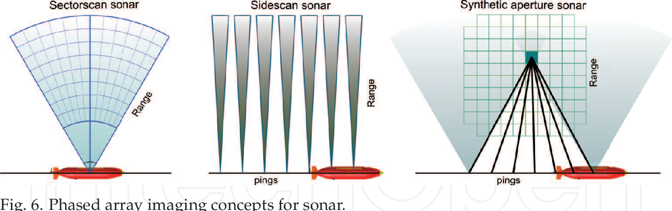
Eel Grass Detection, Mapping, and Monitoring

Slide 36
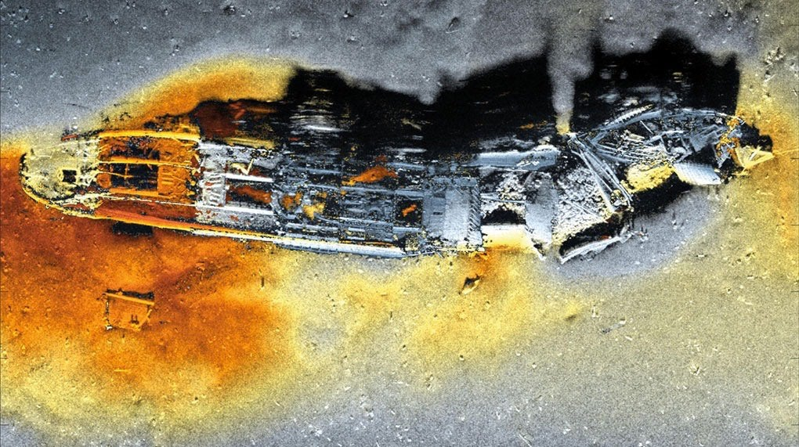
Eel Grass Detection, Mapping, and Monitoring
Synthetic Aperture Sonar Data of Skagerrak Munitions Dump Site
Notes:
Check out SASS underwater archaeology papers for cool pictures

Slide 37
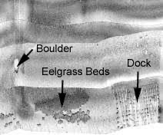
Eel Grass Detection, Mapping, and Monitoring

Slide 38

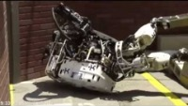
Ask me anything!
Theodore (Ted) Nowak
Data Scientist @ PNNL
theodore.nowak@pnnl.gov

